Slide 1
Object Oriented Programming
Dr. Nachiket Tapas

Slide 2
Scheme
Course Subject | Course Code | End Semester Exam | Class Test | Teacher Assessment
Object Oriented Programming | A000272 (022) | 100 | 20 | 20
Object Oriented Programming Lab | A000291 (022) | 40 | - | 20

Slide 3
Exams
There can be surprise quizzes during the lectures.
There will be an End Semester Exam (ESE) for 100 Marks.
There will be two class tests before the ESE each for 20 marks.

Slide 4
Syllabus
INTRODUCTION
Object oriented programming, Introduction, Application, characteristics, difference between object oriented and procedure programming, Comparison of C and C++, Cout, Cin, Data Type, identifiers.

Slide 5
Contd.
OBJECT AND CLASSES
Implementation of class and object in C++, access modifiers, object as data type, constructor, destructor, Object as function arguments, default copy constructor, parameterized constructor, returning object from function, Structures and classes, Classes objects and memory, static class data, Arrays of object, Arrays as class Member Data, the standard C++ String class, Run time and Compile time polymorphism.

Slide 6
Contd.
OPERATOR OVERLOADING AND INHERITANCE
Overloading unary operators, overloading binary operators, data conversion, pitfalls of operators overloading, Concept of inheritance, Derived class and base class, access modifiers, types of inheritance, Derived class constructors, member function, public and private inheritance.

Slide 7
Contd.
POINTERS AND VIRTUAL FUNCTION
Addresses and pointers, the address-of operator & pointer and arrays, Pointer and Function pointer, Memory management: New and Delete, pointers to objects, debugging pointers, Virtual Function, friend function, Static function, friend class, Assignment and copy initialization, this pointer, dynamic type information.

Slide 8
Contd.
STREAMS AND FILES
Streams classes, Stream Errors, Disk File I/O with streams, file pointers, error handling in file I/O with member function, overloading the extraction and insertion operators, memory as a stream object, command line arguments, printer output, Function templates, Class templates Exceptions, Containers, exception handling.

Slide 9
Labs
In each lab you will be given few problems to solve
You need to prepare the practical file with solution to problems.
You must work on your own.
Discussion is allowed, but sharing of code in any form is NOT permitted.

Slide 10
Textbooks
E. Balaguruswami,” Object Oriented Programming in C++”,TMH.
Robert Lafore, “Object Oriented Programming in C++”,Pearson.
Reference Books
M.T. Somashekare, D.S. Guru, “Object-Oriented Programming with C++”,PHI.
Herbert Shildt, “The Complete Reference C++”, Tata McGraw Hill publication.

Slide 11
Let’s Begin

Slide 12
Introduction
Object-Oriented Programming or OOPs refers to languages that use objects in programming.
Object-oriented programming aims to implement real-world entities like inheritance, hiding, polymorphism, etc in programming.
The main aim of OOP is to bind together the data and the functions that operate on them so that no other part of the code can access this data except that function.

Slide 13
OOP Concepts
Class
Objects
Data Abstraction
Encapsulation
Inheritance
Polymorphism
Dynamic Binding
Message Passing

Slide 14
Class
A class is a user-defined data type.
It consists of data members and member functions, which can be accessed and used by creating an instance of that class.
It represents the set of properties or methods that are common to all objects of one type. A class is like a blueprint for an object.

Slide 15
Object
It is a basic unit of Object-Oriented Programming and represents the real-life entities.
An Object is an instance of a Class.
When a class is defined, no memory is allocated but when it is instantiated (i.e. an object is created) memory is allocated.
An object has an identity, state, and behavior. Each object contains data and code to manipulate the data.

Slide 16
Data Abstraction
Data abstraction refers to providing only essential information about the data to the outside world, hiding the background details or implementation.
Consider a real-life example of a man driving a car. The man only knows that pressing the accelerators will increase the speed of the car or applying brakes will stop the car, but he does not know about how on pressing the accelerator the speed is increasing, he does not know about the inner mechanism of the car or the implementation of the accelerator, brakes, etc in the car.

Slide 17
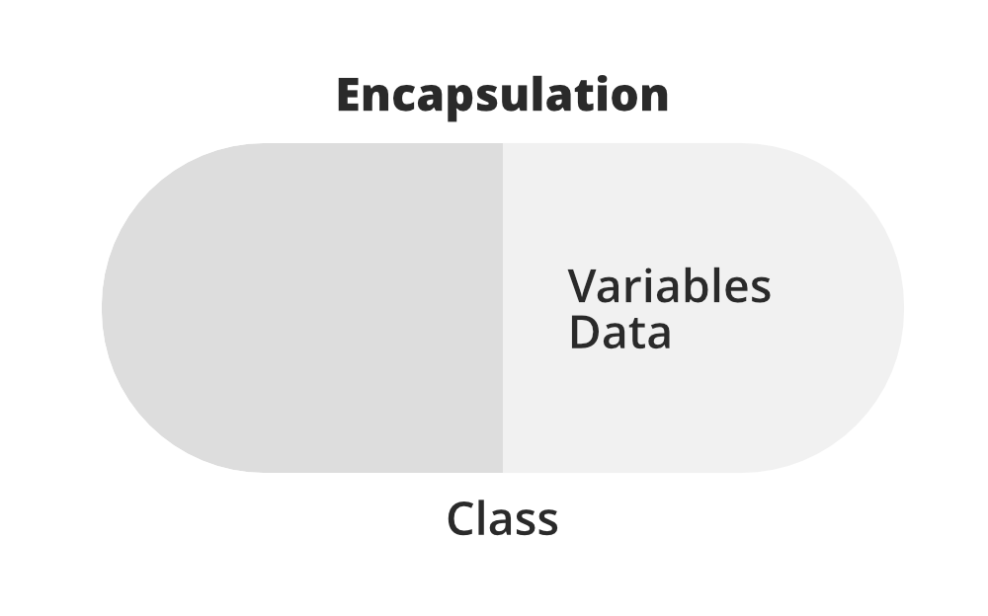
Encapsulation
Encapsulation is defined as the wrapping up of data under a single unit.
It is the mechanism that binds together code and the data it manipulates.
In Encapsulation, the variables or data of a class are hidden from any other class and can be accessed only through any member function of their class in which they are declared.

Slide 18
Example
Consider a real-life example of encapsulation, in a company, there are different sections like the accounts section, finance section, sales section, etc. The finance section handles all the financial transactions and keeps records of all the data related to finance. Similarly, the sales section handles all the sales-related activities and keeps records of all the sales. Now there may arise a situation when for some reason an official from the finance section needs all the data about sales in a particular month. In this case, he is not allowed to directly access the data of the sales section. He will first have to contact some other officer in the sales section and then request him to give the particular data. This is what encapsulation is. Here the data of the sales section and the employees that can manipulate them are wrapped under a single name “sales section”.

Slide 19
Inheritance
The capability of a class to derive properties and characteristics from another class is called Inheritance.
So when we create a class, we do not need to write all the properties and functions again and again, as these can be inherited from another class that possesses it.
Inheritance allows the user to reuse the code whenever possible and reduce its redundancy.

Slide 20
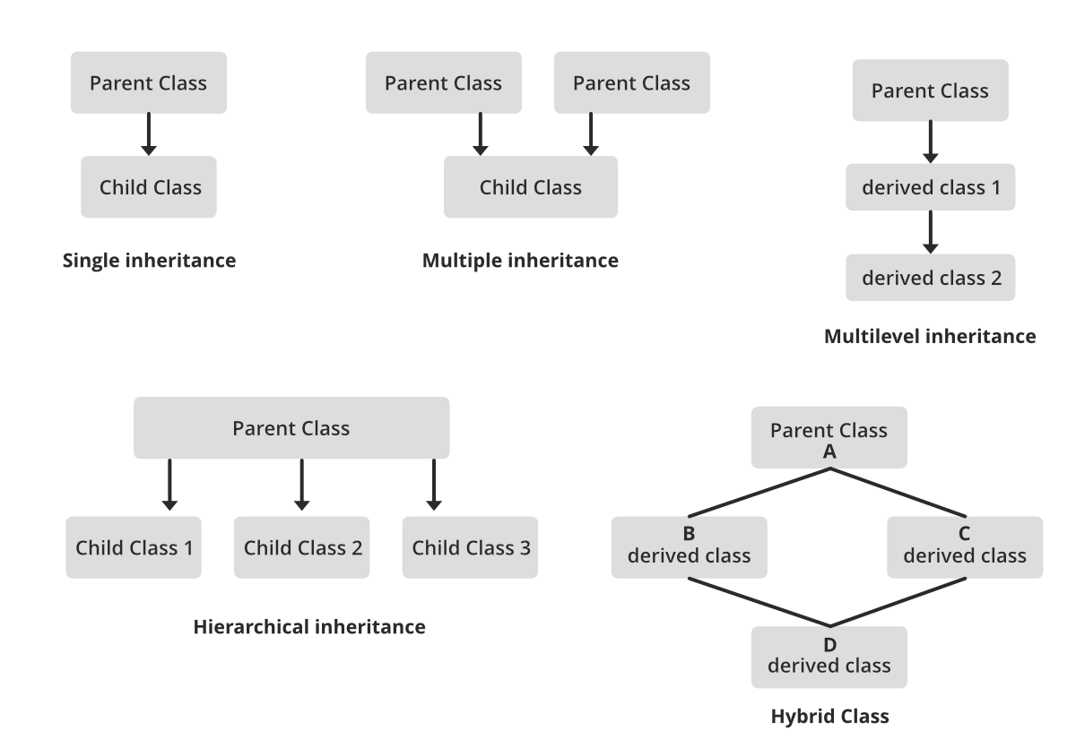
Types

Slide 21
Polymorphism
The word polymorphism means having many forms.
In simple words, we can define polymorphism as the ability of a message to be displayed in more than one form.
For example, A person at the same time can have different characteristics. Like a man at the same time is a father, a husband, an employee. So the same person posses different behavior in different situations. This is called polymorphism.

Slide 22
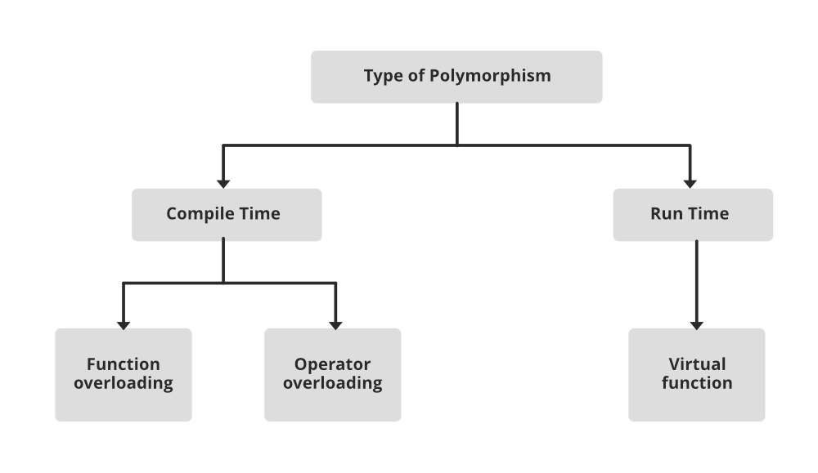
Types

Slide 23
Dynamic Binding
In dynamic binding, the code to be executed in response to the function call is decided at runtime.
Dynamic binding means that the code associated with a given procedure call is not known until the time of the call at run time.
Dynamic Method Binding : One of the main advantages of inheritance is that some derived class D has all the members of its base class B. Once D is not hiding any of the public members of B, then an object of D can represent B in any context where a B could be used. This feature is known as subtype polymorphism.

Slide 24
Message Passing
It is a form of communication used in object-oriented programming as well as parallel programming.
Objects communicate with one another by sending and receiving information to each other.
A message for an object is a request for execution of a procedure and therefore will invoke a function in the receiving object that generates the desired results.
Message passing involves specifying the name of the object, the name of the function, and the information to be sent.

Slide 25
Application: Where is it used?
Mac OS X has large amounts written in C++. Most of the software from Microsoft like Windows, Microsoft Office, IDE Visual Studio, and Internet Explorer are also written in C++.
Most of the applications from Adobe such as Photoshop, Illustrator, etc. are developed using C++.
Mozilla Firefox is completely developed from C++. Google applications like Chrome and Google File System are partly written in C++.
Infosys Finacle is a popular banking application developed using C++.
The world’s most popular open-source database, MySQL, is written in C++.
Tensorflow, one of the most popularly used Machine Learning libraries uses C++ as its backend programming language.

Slide 26
Comparison
Procedural Language | Object Oriented Language
In procedural programming, the program is divided into small parts called functions. | In object-oriented programming, the program is divided into small parts called objects.
Procedural programming follows a top-down approach. | Object-oriented programming follows a bottom-up approach.
There is no access specifier in procedural programming. | Object-oriented programming has access specifiers like private, public, protected, etc.
Adding new data and functions is not easy. | Adding new data and function is easy.
Procedural programming does not have any proper way of hiding data so it is less secure. | Object-oriented programming provides data hiding so it is more secure.
In procedural programming, overloading is not possible. | Overloading is possible in object-oriented programming.
In procedural programming, there is no concept of data hiding and inheritance. | In object-oriented programming, the concept of data hiding and inheritance is used.

Slide 27
Contd.
Procedural Language | Object Oriented Language
In procedural programming, the function is more important than the data. | In object-oriented programming, data is more important than function.
Procedural programming is based on the unreal world. | Object-oriented programming is based on the real world.
Procedural programming is used for designing medium-sized programs. | Object-oriented programming is used for designing large and complex programs.
Procedural programming uses the concept of procedure abstraction. | Object-oriented programming uses the concept of data abstraction.
Examples: C, FORTRAN, Pascal, Basic, etc. | Examples: C++, Java, Python, C#, etc.

Slide 28
Comparison
C | C++
C was developed in 1972 by Dennis Ritchie at Bell Laboratories. | C++ was developed by Bjarne Stroustrup of Bell Laboratories in the early 1980s.
It is a function-driven language. | It is an object-driven language.
C is a Procedural Oriented language. It does not support object-oriented programming (OOP) features such as polymorphism, encapsulation, and inheritance programming. | C++ is both a procedural and an object-oriented programming language. It supports OOP features such as polymorphism, encapsulation, and inheritance.
C is a subset of C++. | C++ is a superset of C.
C has 32 keywords. | C++ has 63 keywords.
Supports built-in data types | Supports both built-in and user-defined data types
The file extension of a program in C language is .c. | The file extension of a C++ program is .cpp.

Slide 29
Contd.
C | C++
Does not have access modifiers. | Has access modifiers.
C uses <stdio.h> header file. | C++ uses <iostream.h> header file.
Data and functions are separated. | Data and functions are encapsulated together.
No support for information hiding. | Data is hidden by Encapsulation. This ensures data structures and operators are used as intended.
C focuses on method or process rather than data. | C++ focuses on data rather than method or procedure.
No direct support for exception handling. | Supports exception handling.
C uses scanf() and printf() functions for input/output. | It uses cin and cout for input/output.

Slide 30
Contd.
C | C++
Does not support function and operator overloading. | Supports function and operator overloading.
The main() function can be called through other functions used in the code. | Does not allow the main() function to be called through other functions.
Uses calloc() and malloc() functions for memory allocation. | Uses the new operator and free() for memory allocation.
Does not support any reference variables. | Supports reference variables.

Slide 31
I/O operations in C++
In C++, input and output (I/O) operators are used to take input and display output.
The operator used for taking the input is known as the extraction or get from operator (>>), while the operator used for displaying the output is known as the insertion or put to operator (<<).

Slide 32
Input Operator >>
#include <iostream>
using namespace std;
int main () {
int a;
cin>>a;
a = a+1;
return 0;
}

Slide 33
Output Operator <<
#include <iostream>
using namespace std;
int main () {
int a;
cin>>a;
a=a+1;
cout<<a;
return 0;
}

Slide 34
Cascading Input and Output Operators
#include <iostream>
int main () {
int a, b;
cin>>a>>b;
cout<<"The value of b is : "<<b;
cout<<"The value of a is "<<a;
return 0;
}
The cascaded input operators wait for the user to input two values and the cascaded output operator first displays the message The value of a is: and then displays the value stored in a. Similar is the case for the next statement.

Slide 35
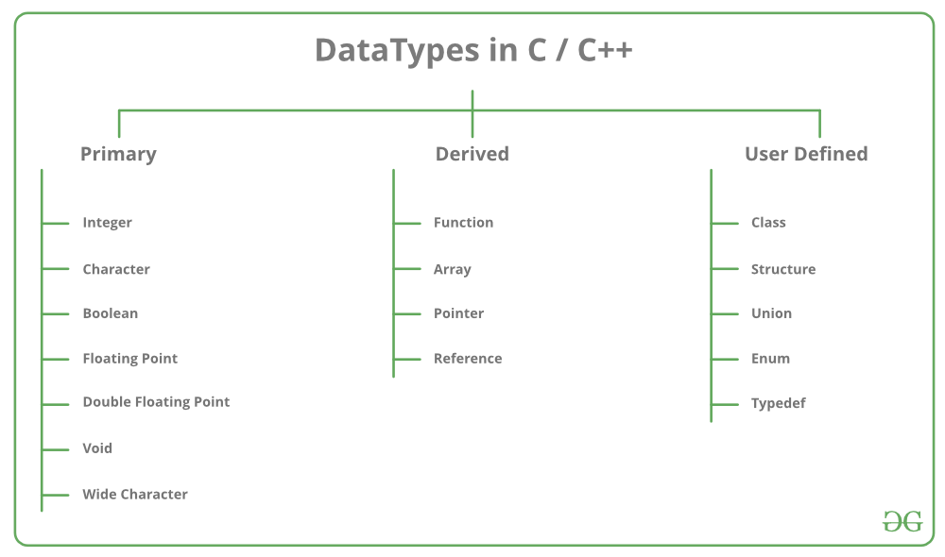
Data Types

Slide 36
Identifiers
All C++ variables must be identified with unique names.
These unique names are called identifiers.
Identifiers can be short names (like x and y) or more descriptive names (age, sum, totalVolume).

Slide 37
General Rule
The general rules for naming variables are:
Names can contain letters, digits and underscores
Names must begin with a letter or an underscore (_)
Names are case sensitive (myVar and myvar are different variables)
Names cannot contain whitespaces or special characters like !, #, %, etc.
Reserved words (like C++ keywords, such as int) cannot be used as names

Slide 38
Thank You!!

